Slide 1
Renewable Sources
Excluding Hydroelectric and Solar has been growing steadily at a CAGR of 8% from 2012 to 2022.

Slide 2
Among renewable sources of energy, Wind is growing the fastest at a CAGR of 11% from 2012 to 2022.

Slide 3
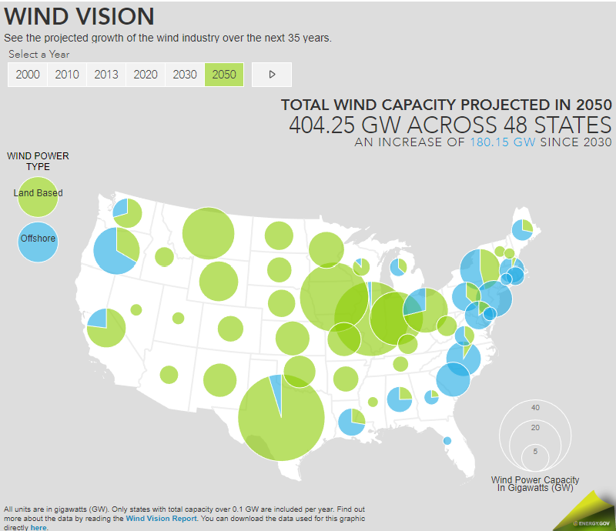
Growth Drivers for Wind Energy
Target to reduce greenhouse gas emissions by half from 2005 levels by 2030
Create a carbon-free power sector in the US by 2035 and to reach net zero emissions by 2050
Improvements in cost and performance of wind power technologies
US Production Tax Credit scheme
https://www.energy.gov/map-projected-growth-wind-industry-now-until-2050

Slide 4
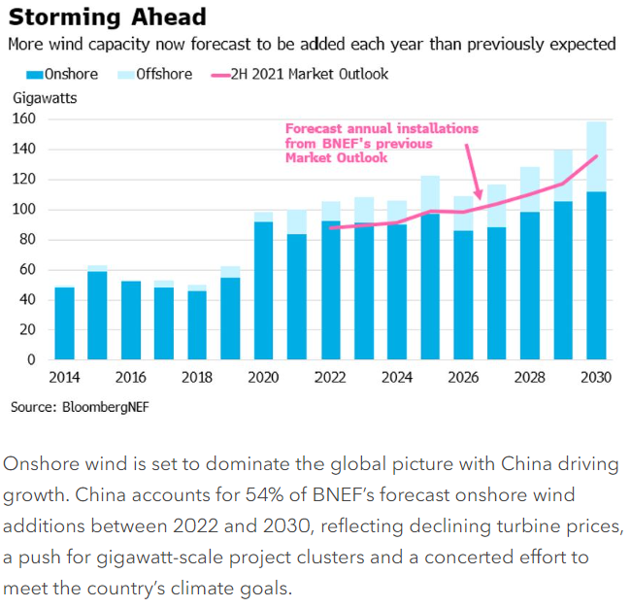
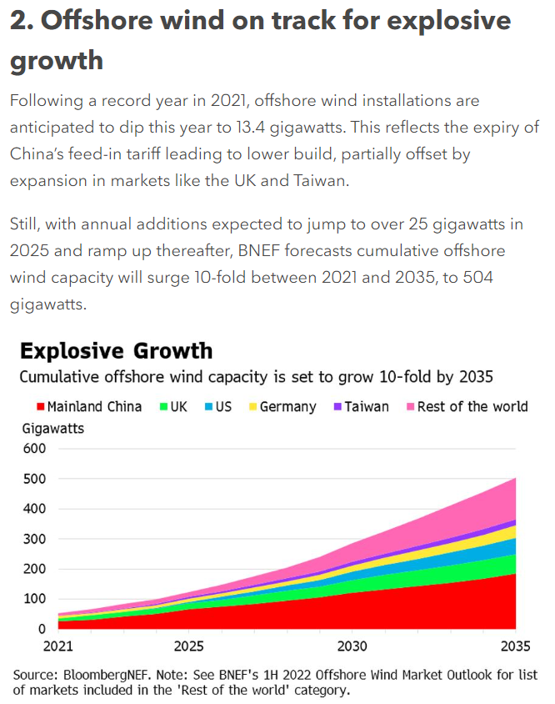
Notes:
https://about.bnef.com/blog/the-next-phase-of-wind-power-growth-in-five-charts/

Slide 5
The amount of electricity generated by wind increased by almost 273 TWh in 2021 (up 17%), 55% higher growth than that achieved in 2020 and the largest of all power generation technologies. Wind remains the leading non-hydro renewable technology, generating 1 870 TWh in 2021, almost as much as all the others combined.
The U.S. wind industry installed 13,413 megawatts (MW) of new wind capacity in 2021, bringing the cumulative total to 135,886 MW. This is the second-highest amount of wind capacity installed in one year (behind 2020), and represents $20 billion of investment. Wind provides more than 9% of electricity nationwide over 50% in Iowa and South Dakota, and over 30% in Kansas, Oklahoma, and North Dakota.

Slide 6
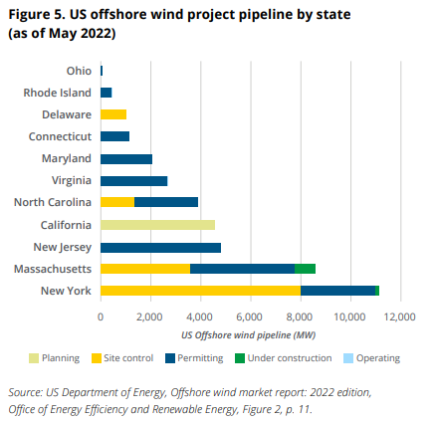
Wind Energy Growth by Region
China was responsible for almost 70% of wind generation growth in 2021, followed by the United States at 14% and Brazil at 7%.
← Can create a chart like this from our dataset

Slide 7
Onshore vs Offshore
In 2021, of the total 830 GW of wind capacity installed, 93% were onshore systems, with the remaining 7% offshore wind farms.
Onshore wind is a developed technology, present in 115 countries around the world, while offshore wind is at the early stage of expansion, with capacity present in just 19 countries. However, offshore reach is expected to increase in the coming years as more countries are developing or planning to develop their first offshore wind farms.
While the rate of onshore wind capacity additions is expected to remain stable in the coming years, offshore systems are set to further accelerate in their existing markets, such as the European Union and China, as well as enter new countries such as the United States, Chinese Taipei and Japan.

